Slide 1
Research in Software Engineering – methods, theories,… basta o cerchiamo?
NTNU, IDI, SU group PhD seminar, 23 Nov. 2007 (rev. 2 Dec. 2007)
Reidar Conradi
Dept. Computer and Information Science (IDI)
NTNU, NO-7491 Trondheim www.idi.ntnu.no/grupper/su/publ/ese/res-methods.ppt conradi@idi.ntnu.no, Tel +47 73.593444, Fax +47 73.594466

Slide 2
Ex. Software crisis - bad software
Some recent Software Engineering (SE) incidents/risks in Norway:
Sparebank 1 Midt-Norge (20 Oct. 2007): 200 000 netbank users got most of their scheduled, monthly transactions run twice. To be reversed the next days.
Adresseavisen (2007): several printing delays due to computer problems.
Skandiabanken (Spring 2007): Electronic burglary of one account.
Jernbaneverket, Sandvika (20 April 2005): Almost train collision due to a stop signal not showing red.
CHAOS Report (1995 and later) by Standish Group.
See www.idi.ntnu.no~/conradi/IT-debate/risks.html

Slide 3
Proposed ”silver bullets” [Brooks87] (1)
What almost surely works:
Software reuse/CBSE/COTS: yes!!
Formal inspections: yes!!
Systematic testing: yes!!
Better documentation: yes!
Versioning/SCM systems: yes!!
OO/ADTs: yes?!, especially in domains like distributed systems and GUI.
High-level languages: yes! - but Fortran, Lisp, Prolog etc. are domain-specific.
Bright, experienced, motivated, hard-working, …developers: yes!!! – brain power.

Slide 4
Proposed ”silver bullets” (2)
What probably works:
Better education: hmm?
UML: often?; but need tailored RUP.
Powerful, computer-assisted tools, Eclipse: partly?
Incr./agile methods, involve users; XP, SCRUM: partly?
More ”structured” process/project (model): probably?, if suited to purpose. But beware of OSS.
Software process improvement; TQM, ISO-9001, CMM: depends?, assumes stability.
”Structured programming”: not clear wrt. maintenance?
Formal specification/verification/code-generation: does not scale up? – only for safety-critical systems, so constructive CBSE has ”won”.
=> Need further studies (”eating”) of these ”puddings”

Slide 5
The next best “silver bullet”:
Empirical Software Engineering (ESE)
Lack of systematic validation in computer science / software engineering vs. other disciplines: [Tichy98] [Zelkowitz98].
(New) technologies not properly validated: OO, UML, …
Empirical / Evidence-based Software Engineering since 1992: writings by [Basili94], [Wohlin00], [Rombach93], Juristo??.
Int’l Software Engineering Research Network (ISERN) group, 1992. ESERNET EU-project in 2001-03.
SE group at NTNU since 1993, at UiO from 1997 – both with ESE emphasis.
SE at Simula Research Laboratory from 2001: attn/ Dag Sjøberg, in coop. with NTNU, SINTEF et al.
SPIQ, PROFIT, SPIKE, EVISOFT, norskCOSI, ... projects on empirical and practical SPI in Norway, 1996-2010.

Slide 6
But ESE not easy, since SE is “special”
Problems in being more “scientific”:
  Most industrial SE projects are unique (goals, technology, people, …), otherwise just reuse software with marginal copy cost!
  Fast change-rate between projects: goals, technology, people, process, company, … – i.e. no stability, meager baselines.
  Also fast change-rate inside projects: much improvisation, with theory serving as back carpet.
  So never enough time to be “scientific” – with theory building, hypotheses, metrics, data collection, analysis, … and actions.
Tens of context factors in software projects: 3**N for trinary factors.
Strong “soft” (human and organizational) factors.
SE learnt by “doing”, not by “reading” experience reports; need realistic projects in SE courses [Brown91].
So how to show effect and causality? Realism vs. rigor?
How can we overcome these obstacles, i.e. to learn and improve systematically? – ESE as the answer? – Or action research? Or …

Slide 7
Ex. “Context” factors/variables
To understand a discipline: must build and validate theories/models that relate some key concepts/factors – incl. context factors.
People factors: number of people, level of expertise, group organization, problem experience, process experience, …
Problem factors: application domain, newness to state of the art, susceptibility to change, problem constraints, …
Process factors: life cycle model, methods, techniques, tools, programming language, other notations, …
Product factors: deliverables, system size, required qualities such as time-to-market, reliability, portability, …
Resource factors: target and development machines, calendar time, budget, existing software, …
Example: 29 factors to predict sw productivity [Walston77].
(from Basili’s CMSC 735 course at Univ. Maryland, fall 1999)

Slide 8
Ex. Four basic parameters in a study (from top-down GQM-method)
Object: a process, a product, any form of model.
Purpose: characterize, evaluate, predict, control, improve, …
Focus (relevant object aspect): time-to-market, productivity, reliability, defect detection, accuracy of estimation model, …
Point of view (stakeholder): researcher, manager, customer, …
- all this involves many factors/variables.

Slide 9
Ex. “U”-model of fault rate vs. size
[Basili84]: the fault rate of modules shrunk as module size and complexity grew in the NASA-SEL environment; other authors had inverse observation – who was right?
Explanation: smaller modules are normally better, but involve more interfaces and often chosen when “(re-)gaining” control.
Above result confirmed by similar studies - but many more factors …
Fault
Rate
Basili: Actual
in NASA
Beleived intuitively
Others: Hypothesized
Size/Complexity

Slide 10
Ex. Estimation models, e.g. by Barry Boehm
Effort = E1 * Size ** 1.07 + E2 % Diseconomy of scale
Duration = D1 * Effort ** 0.38 + D2 % ca. cube root
And many other magic formulaes!
Question: Can “E1” express 29 underlying factors?
And how to calibrate for an organization, and use with sense?
Formal vs. informal (expert) estimation [Jørgensen03]?

Slide 11
Theory building and ESE (1)
  Theory: set of related concepts to describe / understand a certain phenomenon, e.g. as a law or to summarize experiences or lessons-learned.
  Theory must be operationable or ”fruitful”, enabling design and prediction of concrete ”empirical studies” to possibly verify or falsify itself; otherwise just brain spin. So gain trust and generalization over time.
  Law has four parts:
    Phenomena/concepts: what? % V, r, I (see below)
    Relations/propositions/operators: how? % Δ, =, *
    Explanation: why? % Maxwell …
    Constaints/validity: where? % not in plasma/quantum
    Ex. Ohm’s law: ΔV = r * I
  Empirical study: to explore or verify some phenomena/theory; chosen research goal and scope w/ e.g. artifacts, actors and processes, pertinent research method(s), ethical concerns.

Slide 12
Theory building and ESE (2)
  Technology:
    ”what” – concepts, models, languages, executable tools, techniques, methods; related to a theory?
    ”how” and ”why”– entire processes.
    Cost/benefits, with given project context?
  Our phenomena or main study subjects and objects:
    Technology: UML, Java, agile methods, process models, …
    Technical artifacts: rqmnts, designs, code, test data, …
    Actors: humans w/ roles, projects, external stakeholders.
    Context: part of project, in lab exercise, or freestanding.
  Our data/experiences: very diverse, hard and soft, partly controllable and valid, costly!
  Our research methods: superset of those in science, social sciences, engineering!! – over 20 such.

Slide 13
Over 20 research methods for (E)SE [Sindre07]
qualitative
Philosophical
discussion
Literature review
Grounded Theory
Action Research
Field study/Observation
Case study
Post Mortem Analysis
Structured interview
Participative preparations
Proof-of-concept Prototyping
Data mining / Archival studies
analytical
empirical
Design science / VR
Quasi-experiment
Survey
Controlled experiment
Math. modellling
Simulation Benchmarking Testing
Mathematical
proof
quantitative

Slide 14
ESE: common research methods (1)
Philosophical discussion: refreshing, but no end.
Literature review: fetch abstracts first, then read and classify papers, costly, boring? Use google/ontologies more?
Proof-of-concept: developer herself makes feasibility demo.
Prototyping: interactive and gradual refinement of goals and solutions in fast steps.
Design science/Virtual Reality: like prototyping - build a system (oil rig) using an executable and graphic model.
Mathematical modelling: make a mathematical model, often partial differential equations, Newtonian mechanics, or applications of this. GPS satellites apply General Relativity!
Mathematical proof: (manually) verifying a formal model / specifations. Does not scale up, sorry.
Simulation: executing a mathematical/ stochastic model (by math.modelling in 6), to predict and learn – ex. weather, world climate via IPCC.

Slide 15
ESE: common research methods (2)
Benchmarking: comparing different algorithms/models.
Testing: special runs of a program to check its dynamic properties, long time before stabilization – as for large physics experiments – don’t stop too early to falsify!
Participative preparations (”Scandinavian school”): workshop-like design and planning.
Grounded Theory: Generalize words/concepts from texts.
Action Research: researcher & developer overlap in roles.
Field study/Observation: being a “fly on the wall”, or also by automatic logging tools.
Case study: try out new technology in real project.
Structured interview: more open questions than in surveys, brings up lots of insights, transcription takes time, apply Grounded Theory later?

Slide 16
ESE: common research methods (3)
Post Mortem Analysis: collect lessons-learned, by interviews [Birk02].
Data mining / Archival studies: dig out historical data, bottom-up metrics, costly.
Quasi-experiment, in “vivo”, in industry: costly and hard logistics. Use Simula’s SESE web-tool [Sjøberg02]?
Survey: by phone, emailed questionnaires or web servers, costly randomization with “unaccessible” respondents, unreliable census data.
Controlled experiment, “in vitro”, often among students: can control the artifacts, process and outer context.

Slide 17
ESE: different data categories
Quantitative (“hard”) data: mainly numbers according to a predefined metrics, both direct and indirect data. Need suitable analysis methods, depending on the metrics scale – nominal, ordinal, interval, and ratio. Often objective. But: “10000vis av regninger” – false.
Qualitative (“soft”) data: prose text, pictures, … Often from observation and interviews. Need much human interpretation. Often subjective. But: “Norge beat Malta 4-1” - true. Specific data for a given study (e.g. reuse rate) vs.
Common data (cost, size, #faults, …) - “baseline”?

Slide 18
ESE: validity problems
Construct validity: the “right” (relevant, precise, minimal, …) metrics - use Goal-Question-Metrics?
Internal validity: the “right” data values.
Conclusion validity: the right (appropriate) data analysis.
External validity: the “right” (representative) context.

Slide 19
ESE: combining different studies/data (1)
Meta-studies: aggregations over previous single studies. Cf. medicine with Cochran reporting standard. Need shared experience databases?
A composite study may combine several study types and data, sequentially to track SPI:
  Prestudy, doing a survey or post-mortem
  Initial formal experiment, on students
  Sum-up, using interviews
  Final case study, in industry
  Sum-up, using interviews or post-mortem

Slide 20
ESE: combining different studies/data (2)
A composite study may also combine data concurrently, by triangulation to verify status:
  Interviews of project personnel.
  Data mining of ongoing project.
  Case study of same project.
  Independent observation of same project.

Slide 21
Three slides from Tor Stålhane, April 2007: Correlations vs. Causality - 1
Several published papers have an argument roughly as follows:
Corr(A, B) > v, v >> 0, and A precedes B in time.
A ”causes” B.
A
B

Slide 22
Correlations vs. Causality - 2
An observed correlation (v) can however be explained in many ways:
A => B Either this.
X => A, B. Or this, see below figure.
That is, mere coincidences in 1 - see next slide.
A
B
X

Slide 23
Correlations vs. Causality - 3
?
Stork density, A
Birth rate, B
Low degree of urbanisation, X

Slide 24
Achieving validated knowledge: by ESE
Learn about ESE: [Rombach93] [Conradi03].
Set goals, e.g. use QIP [Basili95]?
Need operational methods to perform studies: general [Kitchenham02], on GQM [Basili94]?
Cooperate with others on repeatable studies / experiments (ISERN, ESERNET, …) [Vokác03].
Perform meta-analysis across single studies. Need reporting procedures, databases etc.
Need more industrial studies, not only with students.
Have patience, allocate enough resources. Industrial studies will run into unexpected problems; SPI initiatives have 30-70% “abortion” rate [Conradi02] [Dybå03].

Slide 25
Ex. Some NTNU studies (per 2003, all published)
CBSE/reuse:
Assessing reuse in 15 companies in REBOOT, 1991-95.
Modifiability of C++ programs and documentation, 1995.
Ex3, INCO: COTS usage in Norway, Italy, and Germany 2002-04 (many).
Assessment of COTS components, 2001-02.
Ex2, INCO: CBSE at Ericsson-Grimstad, 2001-04 (many).
Inspections:
Perspective-based reading, at U. Maryland and NTNU, 1995-96.
Ex1, NTNU diploma theses: SDL inspections at Ericsson, 1993-97.
UML inspections at U.Maryland, NTNU and at Ericsson, 2000-02.
SPI/quality:
Role of formal quality systems in 5 companies, 1999.
Comparing process model languages in 3 companies, 1999.
Post-mortem analysis in two companies, 2002.
SPI experiences in SMEs in Scandinavia and in Italy and Norway, 1997-2000.
SPI lessons-learned in Norway (SPIQ, PROFIT), 1997-2002.
And many more!

Slide 26
Ex1. SDL inspections at Ericsson-Oslo 1993-97, data mining study in 3 MSc theses (Marjara et al.)
General comments:
AXE telecom switch systems, with functions around * and # buttons, teams of 50 people.
SDL and PLEX as design and implementation languages.
Data mining study of internal inspection database. No previous analysis of these data.
Study 1: Project A, 20,000 person-hours. Look for general properties + relation to software complexity (by Marjara being a previous Ericsson employee).
Study 2: Project A + Project-releases B-F, 100,000 person-hours. Also look for longitudinal relations across phases and releases, i.e. “fault-prone” modules - seems so, but not conclusive (by Skåtevik and Hantho)
When results came: Ericsson had changed process, now using UML and Java, but with no inspections.

Slide 27
Ex1. General results of SDL inspections at Ericsson-Oslo 1993-97, by Marjara
Activity | Yield = Number of Defects [#] | Total effort on defect detection [h] | Cost- efficiency [defect/h] | Total effort on defect correction [h] | Estimated saved effort by early defect removal (“formulae”) [h]
Inspection preparation, design | 928 | 786.8 | 1.17 | 311.2 | 8200
Inspection meeting, design | 29 | 375.7 | 0.077
Desk Check (Unit Test and Code Review) | 404 | 1257.0 | 0.32 | - | -
Function Test | 89 | 7000.0 | 0.013 | - | -
Total so far | 1450 | 9419.5 | 0.15 | - | -
System Test | 17 | - | - | - | -
Field Use (first 6 months) | 35 | - | - | - | -
Table 1. Yield, effort, and cost-efficiency of inspection and testing, Study 1.
Study 1 overall results:
About 1 person-hour per defect in inspections.
About 3 person-hours per defect in unit test, 80 p-h/defects in function test.
So inspections seem very profitable.

Slide 28
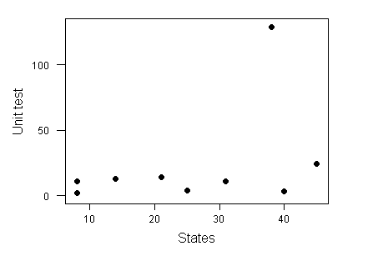
Ex1. SDL-defects vs. size/complexity (#states) at Ericsson-Oslo 1993-97, by Marjara
Defects found in unit test
Defects found during inspections
States
Study 1 results, almost “flat” curve -- why?:
Putting the most competent people on the hardest tasks!
Such contextual information is very hard to get/guess.

Slide 29
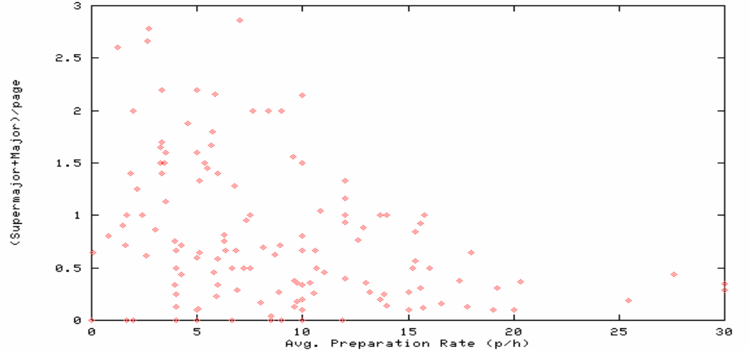
Ex1. SDL inspection rates/defects at Ericsson-Oslo 1993-97, by Marjara
>1
Recommended rate
0.66
actual rate
8
Study 1: No internal data analysis, so no adjustment of insp. process:
- Too fast inspections: so missing many defects.
- By spending 200(?) analysis hours, and ca. 1250 more inspection hours: will save ca. 8000 test hours!

Slide 30
Ex2. INCO, studies and methods by PhD student Parastoo Mohagheghi, NTNU/Ericsson-Grimstad
Study reusable middleware at Ericsson, 600 KLOC, shared between GPRS and UMTS applications:
  Characterization of quality of reusable comp. (pre-case study)
  Estimation of use-case models for reuse – with Bente Anda, UiO (case study)
  OO inspection techniques for UML - with HiA, NTNU, and Univ. Maryland (real experiment)
  Attitudes to software reuse – with two other companies (survey)
  Evolution of product families (post-mortem analysis)
  Improved reuse processes (proposal for case study)
  Reliability and stability of reusable components, based on 13,500 (!) change requests – with NTNU (case study/data mining), next three slides

Slide 31
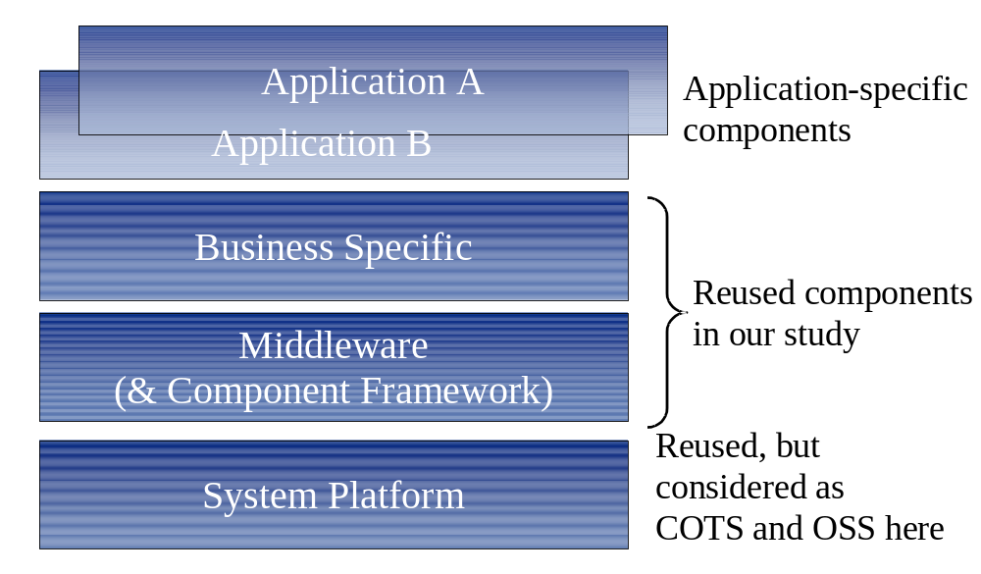
Ex2. GPRS/UMTS system at Ericsson-Grimstad

Slide 32
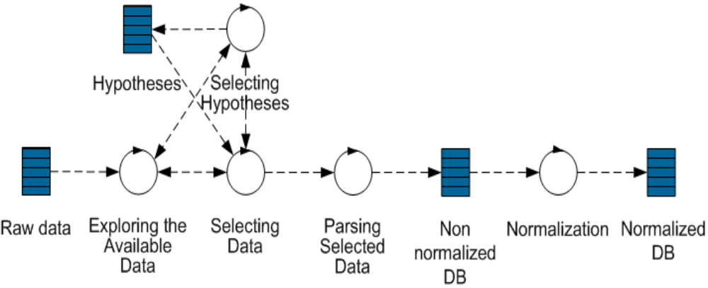
Ex2. Research design (data mining)

Slide 33
Ex.2 Hypotheses testing (as null-hyp.)
H01: Reused components have same fault-density as non-reused components. Rejected - reused more reliable.
H02a: There is no relation between #faults and component size for all components. Not rejected - not incr. with size.
H02b: There is no relation between #faults and component size for reused components. Not rejected - not incr. with size for reused.
H02c: There is no relation between #faults and component size for non-reused components. Rejected - incr. with size for non-reused.
H03a/b/c: There is no relation between fault-density and component size for all/reused/non-reused components. Not rejected.
H04: Reused and non-reused components are equally modified. Rejected - reused more stable.

Slide 34
Ex3. COTS usage contradicts “common wisdom”
In INCO, structured interviews of 7 Norwegian and Italian SMEs:
Thesis T1: Open-source software is often used as closed source.
Thesis T2: Integration problems result primarily from lack of compliance with standards; not architectural mismatches.
Thesis T3: Custom code is mainly devoted to add functionalities.
Thesis T4: Formal selection seldom used; rather familiarity with product or generic architecture.
Thesis T5: Architecture more important than requirements to select components. - Reidar: no longer true; better standards.
Thesis T6: Tendency to increase level of control over vendor whenever possible.
See [Torchiano04].
Extended with larger Norwegian OSS/COTS survey by NTNU and Simula, later repeated in Germany and Italy [Li08].

Slide 35
From 50 software “laws” [Endres03]:
L1, Glass: Requirement deficiencies are the prime cause of project failures.
L5, Curtis: Good designs require deep application domain knowledge.
L12, Corbató: Productivity and reliability depend on the length of a program’s text, independent of language level used.
L16, Conway: A system reflects the organizational structure that built it.
L23, Weinberg: A developer is unsuited to test his or her code.
L27, Lehman-1: A system that is used will be changed.

Slide 36
More from 50 software “laws”:
L30, Basili-Möller: Smaller changes have a higher error density than large ones.
L36, Brooks: Adding manpower to a late project makes it later.
L45, Moore: The price/performance of processors is halved every 18 month.
L47, Cooper: Wireless bandwidth doubles every 2.5 years.
L49, Metcalfe: The value of a network increases with the square of its users.

Slide 37
Some of the 25 hypotheses, also from [Endres03]:
H2, Booch-2: Object-oriented designs reduce errors and encourage reuse.
H5, Dahl-Goldberg: Object-oriented programming reduce errors and encourage reuse.
H9, Mays: Error prevention is better than error removal.
H16, Wilde: Object-oriented programs are difficult to maintain.
H25, Basili-Rombach: Measurements require both goals and models.

Slide 38
Conclusion (1)
Best practices: depend on context, so must know more about that relation!!
Need feedbacks from and cooperation with industry to be helpful – our “laboratory”! Compensate industry.
Seek relevance of data to actual goal/hypothesis!
But unused data worse than no data?
ESE: promising, but hard. Research design? Statistics?
High ESE / SPI activity in Norway since 1997.
Much international cooperation.

Slide 39
Conclusion (2)
Higher R&D spending in Norway?: only 1.55% of GNP (2005), in spite of parliamentary promises from April 2000 on reaching OECD-level (2.25%) in 4 years.
Ex. NFR is using 150 MNOK per year on basic software research – as much as the three best Norwegian football players earn per year!
Standardized formats for reporting empirical studies? Ex. Kreftregisteret for medicine, SSB for general data, Air traffic authority, Water research institute etc. – what public “bureau” is for (empirical) software engineering?
Chinese proverb:
  invest for one year - plant rice,
  invest for ten years – plant a tree,
  invest for 100 years – educate people.

Slide 40
Appendix 1: Some useful web addresses
Fraunhofer Institute for Experimental Software Engineering (IESE), Kaiserslautern: www.iese.fhg.de
International Software Engineering Research Network (ISERN): www.iese.fraunhofer.de/isern
Fraunhofer Center for Experimental Software Engineering, Univ. Maryland (FC-MD): http://fc-md.umd.edu
EU-network on Experimental Software Engineering (ESERNET, 2001- end-2003): www.esernet.org
Software engineering group (SU) at IDI, NTNU: www.idi.ntnu.no/grupper/su/
Industrial software engineering group (ISU) at UiO: www.ifi.uio.no/~isu/
SINTEF Telecom and Informatics: www.sintef.no
Simula Research Laboratory, Oslo: www.simula.no (see under “research” and then “Software Engineering”)
EVISOFT project: www.idi.ntnu.no/grupper/su/evisoft.html (NTNU one).

Slide 41
Appendix 2: Literature list (1)
[Basili84] Victor R. Basili, Barry T. Perricone: “Software Errors and Complexity: An Empirical Investigation”, Commun. ACM, 27(1):42-52, 1984 (NASA-SEL study).
[Basili94] Victor R. Basili, Gianluigi Caldiera, and Hans Dieter Rombach: "The Goal Question Metric Paradigm", In John J. Marciniak (Ed.): Encyclopedia of Software Engineering -- 2 Volume Set, John Wiley and Sons, 1994, p. 528-532, 1994.
[Basili95] Victor R. Basili and Gianluigi Caldiera: “Improving Software Quality by Reusing Knowledge and Experience”, Sloan Management Review, 37(1):55-64, Fall 1995 (on Quality Improvement Paradigm, QIP).
[Basili01] Victor R. Basili and Barry Boehm: “COTS-Based Systems Top 10 List”, IEEE Computer, 34(5):91-93, May 2001.
[Birk02] Andreas Birk, Torgeir Dingsøyr, and Tor Stålhane: "Postmortem: Never leave a project without it", IEEE Software, 19(3):43-45, May/June 2002.
[Brooks87] Frederick P. Brooks Jr.: No Silver Bullet - Essence and Accidents of Software Engineering. IEEE Computer, 20(4):10-19, April 1987.
[Brown91] John Seely Brown and Paul Duguid: "Organizational Learning and Communities of Practice: Toward a Unified View of Working, Learning, and Innovation, Organization Science, 2(1):40-57 (Feb. 1991).
[Conradi02] Reidar Conradi and Alfonso Fuggetta: "Improving Software Process Improvement", IEEE Software, 19(4):92-99, July/Aug. 2002.
[Conradi03] Reidar Conradi and Alf Inge Wang (Eds.): Empirical Methods and Studies in Software Engineering -- Experiences from ESERNET, Springer Verlag LNCS 2765, ISBN 3-540-40672-7, Aug. 2003, 278 pages.
[Dybå03] Tore Dybå: "Factors of SPI Success in Small and Large Organizations: An Empirical Study in the Scandinavian Context", In Paola Inverardi (Ed.): "Proceedings of the Joint 9th European Software Engineering Conference (ESEC'03) and 11th SIGSOFT Symposium on the Foundations of Software Engineering (FSE-11)“, Helsinki, Finland, 1-5 September, ACM Press, pp. 148-157.

Slide 42
Appendix 2: Literature list (2)
[Endres03] Albert Endres and Hans-Dieter Rombach: A Handbook of Software and Systems Engineering: Empirical Observations, Laws, and Theories, Fraunhofer IESE / Pearson Addison-Wesley, 327 p., ISBN 0 321 154207, 2003.
[Jørgensen03] Magne Jørgensen, Dag Sjøberg, and Ulf Indahl: “Software Effort Estimation by Analogy and Regression Toward the Mean”, Journal of Systems and Software, 68(3):253-262, Nov. 2003.
[Kitchenham02] Barbara A. Kitchenham, Susan Lawrence-Pfleeger, L.M. Pickard, P.W. Jones, D.C. Hoaglin, Khalid El Emam, and J. Rosenberg: "Preliminary guidelines for empirical research in software engineering", IEEE Trans. on Software Engineering, 28(8):721-734, Aug. 2002.
[Li08] Jingyue Li, Reidar Conradi, Christian Bunse, Marco Torchiano, Odd Petter N. Slyngstad, and Maurizio Morisio: "Development with Off-The-Shelf Components: 10 Facts", Forthcoming in IEEE Software in 2008, 11 p.
[PITAC99] President’s Information Technology Advisory Committee: “Information Technology Research: Investing in Our Future”, 24 Feb. 1999, http://www.hpcc.gov/pitac/.
[Rombach93] Hans-Dieter Rombach, Victor R. Basili, and Richard W. Selby (Eds.): Experimental Software Engineering Issues: Critical Assessment and Future Directives, Springer Verlag LNCS 706, 1993, 261 p. (from International Workshop at Dagstuhl Castle, Germany, Sept. 1992).
[Sjøberg02] Dag Sjøberg, Bente Anda, Erik Arisholm, Tore Dybå, Magne Jørgensen, Amela Karahasanovic, Espen Koren, and Marek Vokác: ”Conducting Realistic Experiments in Software Engineering”, ISESE’02, Nara, Japan, October 3-4, 2002, pp. 17-26, IEEE CS Press (about SESE web-tool – an Experiment Support Environment for Evaluating Software Engineering Technologies).

Slide 43
Appendix 2: Literature list (3)
[Sindre07] Guttorm Sindre: “Forelesningsfoiler til DT8108 IT-emner –2007, IDI, NTNU, http://www.idi.ntnu.no/emner/dif8916/pdfs/forelesninger/Analytic.pdf (til felles metodekurs for alle IDIs dr.studenter, foil 1, senere tilpasset av Reidar C.).
[Tichy98] Walter F. Tichy: "Should Computer Scientists Experiment More", IEEE Computer, 31(5):32-40, May 1998.
[Torchiano04] Marco Torchiano and Maurizio Morisio: "Overlooked Facts on COTS-based Development", Forthcoming in IEEE Software, Spring 2004, 12 p.
[Vokác03] Marek Vokác, Walter Tichy, Dag Sjøberg, Erik Arisholm, and Magne Aldrin: “A Controlled Experiment Comparing the Maintainability of Programs Designed with and without Design Patterns – a Replication in a real Programming Environment”, Journal of Empirical Software Engineering, 9(3): 149-195 (2004).
[Walston77] C. E. Walston and C. P. Felix: "A Method of Programming Measurement and Estimation“, IBM Systems Journal, 16(1):54-73, 1977.
[Wohlin00] Claes Wohlin, Per Runeson, M. Höst, M. C. Ohlsson, Björn Regnell, and A. Wesslén: Experimentation in software engineering: An introduction, Kluwer Academic Publishers, 2000. ISBN 0-792-38682-5, 224 pages.
[Zelkowitz98] Marvin V. Zelkowitz and Dolores R. Wallace: "Experimental Models for Validating Technology", IEEE Computer, 31(5):23-31, May 1998.

Slide 44
Appendix 3: SU group at NTNU
IDI’s software engineering (SU) group:
Five faculty members: Reidar Conradi, Tor Stålhane, Letizia Jaccheri, Monica Divitini, Alf Inge Wang.
Five researchers/postdocs: Sobah A. Petersen, Anna Trifonova, Jingyue Li, Sven Ziemer, Thomas Østerlie,
12 active PhD-students, 4 more from 2008; common core curriculum in empirical research methods.
30-40 MSc-cand. per year, 2-3 PhDs per year.
Research-based education: students participate in projects, project results are used in courses.
A dozen R&D projects, basic and industrial, in all our research fields – industry is our lab.
Half of our papers are based on empirical research, and 25% are written with international co-authors.

Slide 45
Research fields of SU group (1)
Software Quality: reliability and safety, software process improvement, process modelling
Software Architecture: CBSE: OSS and COTS, versioning, evolution
Co-operative Work: learning, awareness, mobile technology, computer games, project work
In all this:
Empirical methods and studies in industry and among students, experience bases.
Software engineering education: partly project-based.
Tight cooperation with Simula Research Laboratory/UiO and SINTEF, 15-20 active companies, Telenor R&D, Abelia/IKT-Norge etc.

Slide 46
Research fields of the SU group (2)
CBSE: OSS,COTS,
Evolution, SCM
Software
quality
Software
architecture
Reliability,
safety
SPI, learning organisations
Computer games
Software
Engineering
Education
Co-operative
work
Mobile
technology

Slide 47
SU research projects since 2000, part 1
Supported by NFR, basic research:
CAGIS-2, 1999-2002: distributed learning environments, COO lab, Ekaterina Prasolova-Førland (Divitini).
MOWAHS, 2001-04: mobile technologies, Carl-Fredrik Sørensen (Conradi); coop. with DB group.
INCO, 2001-04: incr. and comp.-based development, Parastoo Mohagheghi at Ericsson (Conradi); with Simula/UiO.
WebSys, 2002-05: web-systems – reliability vs. time-to-market, Sven Ziemer and Jianyun Zhou (Stålhane).
BUCS, 2003-06: business critical software, Jon A. Børretzen, Per T. Myhrer and Torgrim Lauritsen (Stålhane and Conradi).
SEVO, 2004-2007: software evolution, Anita Gupta and Odd Petter N. Slyngstad (Conradi), with Statoil-IT.
FABULA, 2006-09, mobile learning, Ilari Canovaca Calori, Basit Ahmed Khan, NN (Divitini).

Slide 48
SU research projects, part 2
Supported by NFR, user-driven:
SPIQ & PROFIT, 1996-2002: industrial sw process improvement, Tore Dybå, Torgeir Dingsøyr (Conradi); with Simula/UiO, SINTEF, Abelia, and 10 companies.
SPIKE, 2003-05: industrial sw process improvement, Finn Olav Bjørnson (Conradi); with Simula/UiO, SINTEF, Abelia, and 10 companies - successor of SPIQ and PROFIT. Book on Springer.
EVISOFT, 2006-10, empirically-driven process improvement, Vital, 10 companies, Simula & SINTEF, Geir Kjetil Hanssen, NN (Conradi, Stålhane) – successor of SPIKE etc.
NorskCOSI, 2006-2008: OSS in Europe, IKT-Norge and three companies, Sven Ziemer, Thomas Østerlie, Øyvind Hauge by IDI (Conradi).

Slide 49
SU research projects, part 3
IDI/NTNU-supported:
Software security, 2002-06: Siv Hilde Houmb (Stålhane).
Component-based development, 2002-06: OSS survey, Jingyue Li (Conradi).
ESE/Empirical software engineering, 2003-07 (SU funds): open source software, Thomas Østerlie (Jaccheri).
KRITT, Sart: Creative methods in education/software and art, 2003-09 (NTNU): novel educational practices, Salah Uddin Ahmed (Jaccheri).
MOTUS, 2002-2006 (NTNU), pervasive and cooperative computing, Birgit R. Krogstie, Eli M. Morken (Divitini), Telenor R&I.
GAMES, Computer games, 2007-10,Telenor R&I and IME-faculty, NN1, NN2, NN3 (Alf Inge Wang).
Supported from other sources:
ESERNET, 2001-03 (EU): network on Experimental Software Engineering, no PhD, Fraunhofer IESE + 25 partners. Book on Springer.
Net-based cooperation learning, 2002-06 (HiNT): learning and awareness, CO2 lab, Glenn Munkvold (Divitini).
ASTRA, 2006-09 (EU), awareness and mobile technology, Otto Helge Nygård (Divitini).

Slide 50
Ex. EVISOFT: Evidence-based Software Improvement
NFR industrial R&D project, 2006-10. NTNU, SINTEF, UiO/Simula, Vital. 3 PhD stud. (NTNU, UiO), 5-10 researchers, 10 active companies. NFR funding: 8 mill. NOK/year, covers direct expenses.
Project manager: Tor Ulsund, Vital ex.Geomatikk.
Builds on SPIQ (1996-99), PROFIT (2000-02), SPIKE (2003-2005)
Help (“facilitate”) IT companies to improve, by pilot projects in each company: e.g. on cost estimation and risk analysis, UML-driven development, agile methods, component-based software engineering (CBSE) – coupled with quality/SPI efforts.
Couple academia and industry: win-win in profile and effect, by action research.
Empirical studies – in/across companies and with other projects
General results: Method book, reports and papers, experience clusters, shared meetings and seminars

Slide 51
Project model in EVISOFT
Dissemination
Common projects (generalization)
Dissemination
Company project (pilot project)
Act
Next company project
Plan
Do
Check
Development/implementation project

Slide 52
Student assignments: linked to ongoing R&D projects
Conradi: process improvement, SCRUM, CBSE / open source, sw evolution. Companies: Vital, EDB, Opera, Skattedirektoratet.
Divitini: Coop. technology,awareness. Telenor, NTNU and pedagogics.
Jaccheri: open source, software and art, pedagogics, research methods. Falanx.
Stålhane: reliability, safety, defect analysis. Vital, EDB, Opera.
Wang: Computer games, mobile systems, sw architecture. Telenor.

